Slide 1


FinSight AI
Automated Personal Finance & Bank Statement Intelligence Platform with Privacy-First Edge AI

Slide 2
The Challenge
Unstructured Indian Bank CSV Statements & Lack of Privacy-Preserving AI Financial Guidance

Slide 3



Problem Statement vs FinSight AI
Legacy Personal Finance Pain
FinSight AI Engine
Manual entry is tedious. Native bank CSVs contain multi-line metadata headers and noisy UPI strings that traditional apps fail to parse cleanly.
Regex-powered CSV parser automatically strips headers and isolates counterparty merchant names from noisy UPI logs.
Most tools upload raw user credentials to centralized cloud servers, raising grave data privacy concerns.
PostgreSQL Row Level Security (RLS) and serverless Edge Functions proxy AI queries without exposing secret keys.

Slide 4
Key Technical Capabilities
Automated Header Stripping: Intelligently skips variable metadata rows in Indian Bank CSV statements before processing.
UPI Regex Merchant Extraction: Extracts clean merchant identities from messy VPA handles (e.g., Swiggy, Airtel, Myntra).
Predictive Recurring Bill Detector: Scans 30-day debit frequencies to detect utilities and active subscriptions automatically.
Conversational Gemini Advisory: Serverless Edge Function proxying for contextual budget recommendations.

Slide 5






Product Core Modules
Smart Statement Ingestion
Health Score Analytics
Serverless AI Advisor
Parses debit/credit flags, normalizes transaction currencies, and applies deterministic spending auto-categorization.
Calculates real-time financial health index (0-100) based on savings rate, budget variance, and spending velocity.
Gemini AI integration answering financial queries while keeping API keys isolated in Supabase Edge Functions.

Slide 6
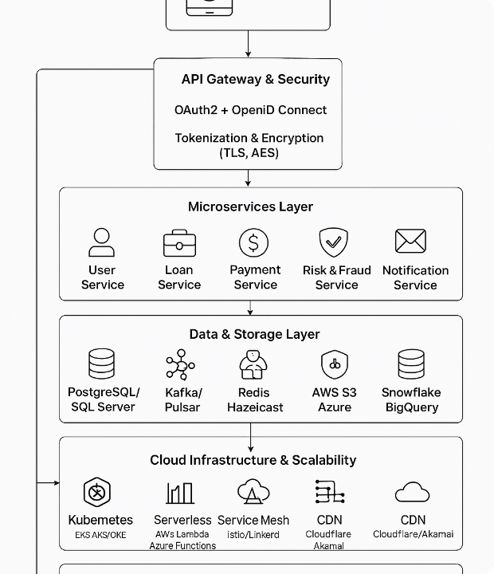
Enterprise Security Architecture
PostgreSQL Row Level Security
All database tables enforce strict auth.uid() = user_id isolation, guaranteeing zero cross-tenant data leakage.
Bot protection via Cloudflare Turnstile CAPTCHA protects authentication endpoints from automated brute-force attacks.

Slide 7
System Architecture & Stack
Modern Full-Stack Architecture Built for Speed, Scalability, and Absolute Privacy

Slide 8
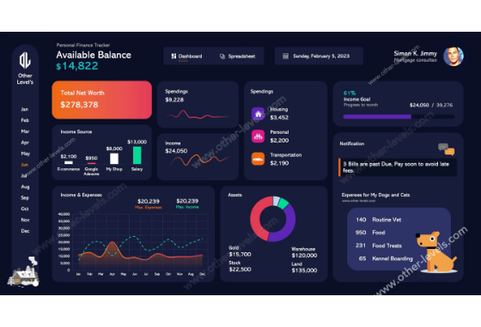
Intelligent Ingestion & Dashboard
Real-Time Insights
The interactive dashboard leverages Recharts to visualize spending distribution, monthly savings velocity, and account balances.
Users can manage multiple bank accounts and switch currencies seamlessly while receiving instant bill due alerts.

Slide 9

Quantifiable Platform Impact
100%
Performance Benchmarks
0 Seconds Manual Entry: Instant CSV parsing handles thousands of transactions in seconds.
Zero Client Secret Exposure: All AI calls route strictly through server-side environment secrets.
Client Data Isolation

Slide 10
Competitive Platform Analysis
Capability | Traditional Budget Apps | FinSight AI
Indian Bank UPI Statement Support | Fails on metadata headers | Regex metadata & merchant cleaner
Data Privacy & Isolation | Centralized shared databases | PostgreSQL Row Level Security (RLS)
Conversational Advisory | Static rule charts | Google Gemini AI via Serverless Edge
Predictive Bill Tracking | Manual entry required | Automated 30-day cadence heuristic

Slide 11
Platform Development Roadmap
Phase 2 - Security
Phase 4 - Expansion
Supabase RLS policies and Cloudflare Turnstile integration.
Multi-currency engine, account aggregation, and OCR support.
Phase 1 - Ingestion
Phase 3 - AI Intelligence
Indian Bank CSV parser with regex VPA cleaner and DR/CR mapping.
Serverless Edge Functions proxying Google Gemini API.

Slide 12
Thank You!
FinSight AI — Smart, Secure, Privacy-First Personal Finance
Repository: github.com/devanshjaiswal404/HackInMotion-RICR-HIM-1155

Slide 13


Image Sources
https://www.c-sharpcorner.com/article/designing-a-modern-fintech-system-architecture-technologies-and-real-world/Images/FinTect-Tech-Stack.png
Source: www.c-sharpcorner.com
http://other-levels.com/cdn/shop/products/Personal-Finance-Excel-Template-_-Advanced-Budgeting-Tool-Other-Levels-17250273.png?v=1759939088
Source: other-levels.com

